Slide 1

CSE 306 MPMC Project Presentation

Slide 2
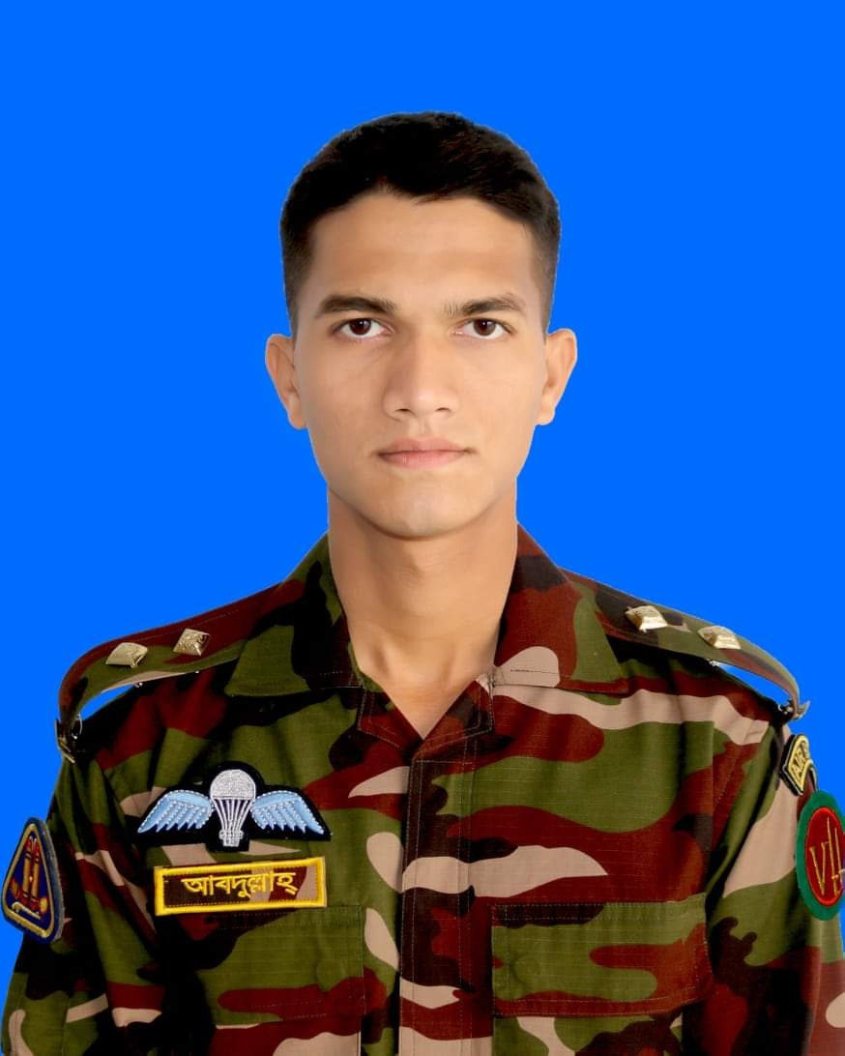
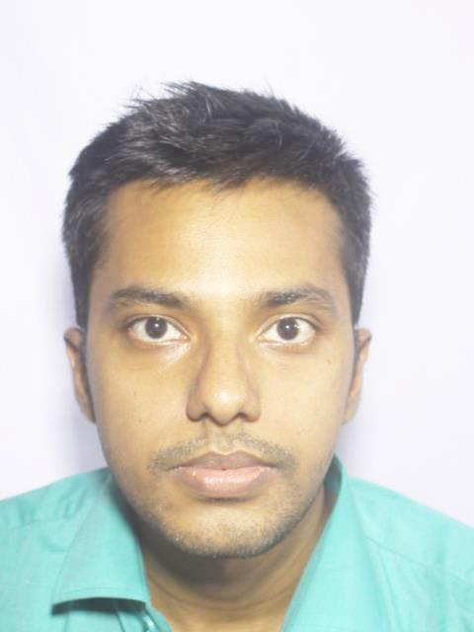

Group Members
Abdullah Al Mahmud
ID: 201814101
Student of MIST
Abdullah Al Masum ID: 201914044
Student of MIST
Riasat Haque
ID: 201914042
Student of MIST

Slide 3
Project Durotto
#

Slide 4
Project Objective
To create a simple and affordable solution of maintaining social distance in this pandemic situation

Slide 5
Project Description
We will create an arduino based project which will help it's user to maintain social distance from all direction around him. To do that, we have decided to place the sensors outside of a cap. When any stranger will come close to the user, a buzzer will alert the user and red LED will be light up. For simplicity, we will use ultrasonic distance sensor to keep maintain the safe distance.

Slide 6
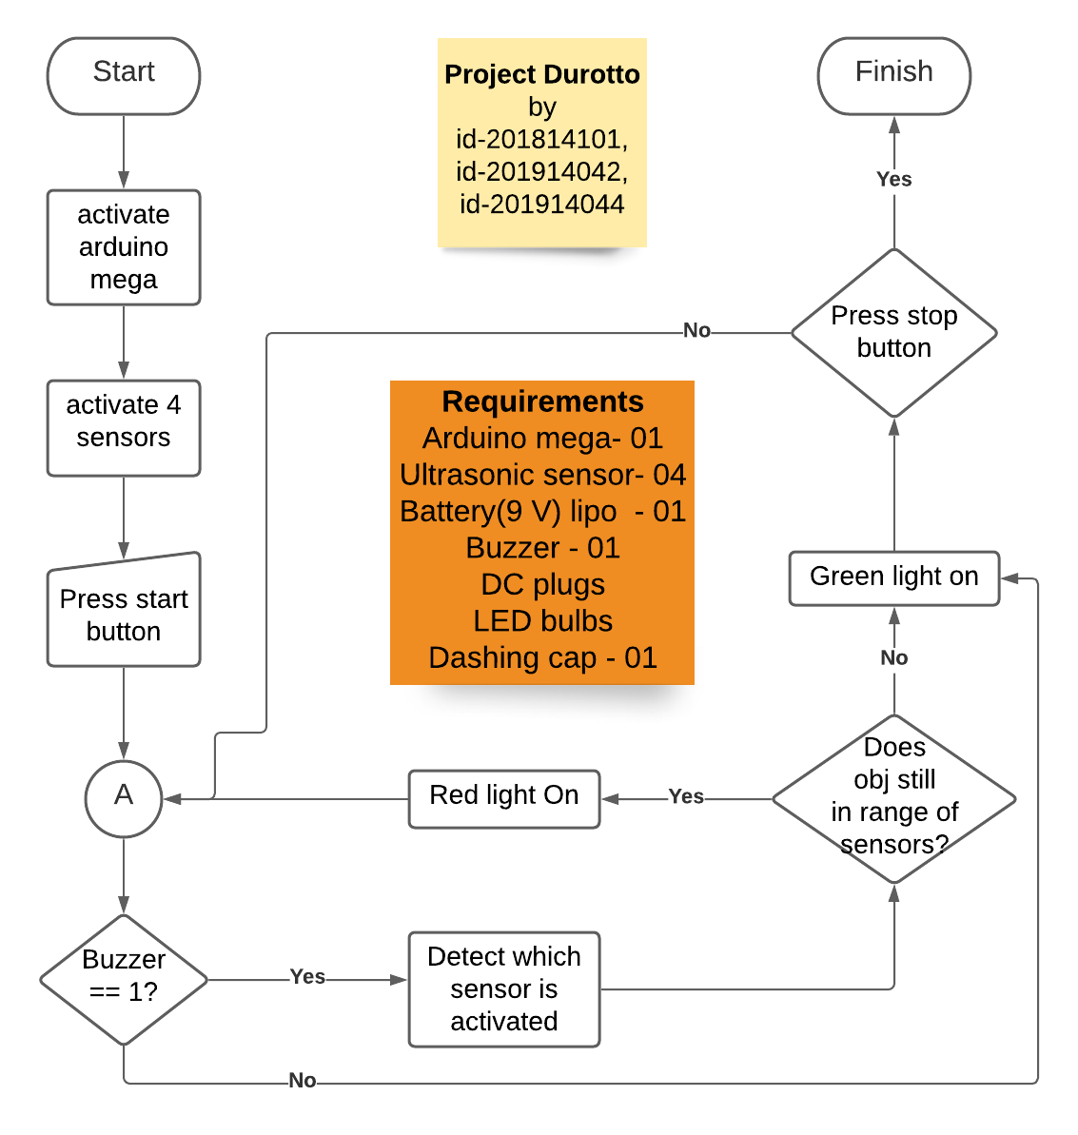
Flow Diagram
Components:
Arduino uno - 01
Ultrasonic sensor - 04
Rechargable Battery(9 V)lipo- 01
Buzzer - 01
Jumping wires
LED bulb
Dashing cap - 01

Slide 7
Work Procedure
We tried to make the procedure as simple as possible
First, connect with the battery
Wear the cap and enjoy
That simple!!
Our code link here

Slide 8
Features
Object detecting
Distance measures from 4 directions
Siren tone with buzzer
Red light bulb

